Slide 1
UMLC 2020 x Blockchain Final Presentation
GIST College, 7th Semester
School of EECS
Suwhoan Lim (임수환)

Slide 2

Table of Contents
Research Topic
Secret Sharing Scheme
2.1 Lagrange Interpolation
Implementation
3.1 Jupyter Notebook
3.2 Truffle, Ganache, WLS
Future work
Notes:
Restate the research topic.
Explain why we need this, why we need blockchain in an e-voting scheme and why we need this secreting sharing scheme in the protocol.
What is secret sharing scheme and how it works
I have preparid today’s presentation to give you more background information about what this is all about.

Slide 3
1. Research Topic
Blockchain Voting – In terms of Confidentiality and Security
Python-Solidity interaction via web3py python library - Implementation of Shamir's Secret Sharing Scheme
Notes:
It’s quite niche. In a bigger picture, I am trying to implement a blockchain voting scheme focused on confidentiality and security. Let’s look at how it works out.

Slide 4
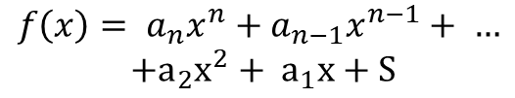
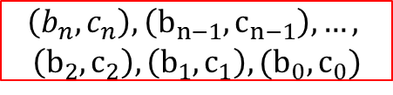

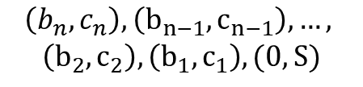
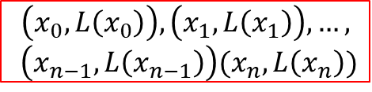
2.1 SSSS - Encryption
Axiom 1: There exists one and only one degree n polynomial that goes through n+1 distinct points
Method 1
Decide a degree n polynomial.
Extract n+1 points
$${f\left(x\right)= a}_{n}x^{n}+a_{n−1}x^{n−1}+ …$$
$$+a_{2}x^{2}+ a_{1}x+S$$
$$\left(x_{0}, L\left(x_{0}\right)\right), \left(x_{1}, L\left(x_{1}\right)\right), …,$$
$$\left(x_{n−1}, L\left(x_{n−1}\right)\right)(x_{n}, L\left(x_{n}\right))$$
Method 2
Decide n points
Find a degree n polynomial that crosses n points + the secret
Extract one more point from the polynomial
$$\left(b_{n}, c_{n}\right), \left(b_{n−1}, c_{n−1}\right), …,$$
$$\left(b_{2}, c_{2}\right), \left(b_{1},c_{1}\right), (0, S)$$
$$g\left(x\right)=Q\left(x^{n}\right)+S, Q\left(0\right)=0$$
$$\left(b_{n}, c_{n}\right), \left(b_{n−1}, c_{n−1}\right), …,$$
$$\left(b_{2}, c_{2}\right), \left(b_{1},c_{1}\right), (b_{0}, c_{0})$$
Notes:
Method 1
We only need to consider the coefficients of the polynomial
Axiom 1 works In both ways, both encryption and decryption

Slide 5
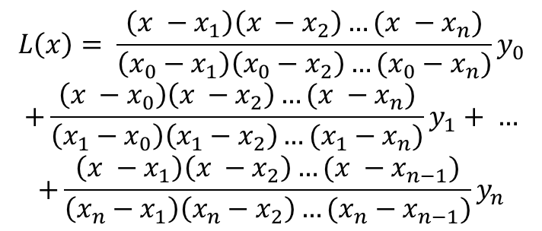
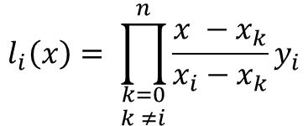
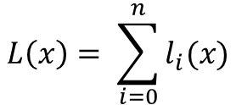
2.2 SSSS – Decryption / Lagrange Intp.
Axiom 2: Given n+1 points, one can find an unique degree n polynomial
Lagrange Interpolation
$$\left(x_{0}, y_{0}\right), \left(x_{1},y_{1}\right), …, \left(x_{n−1}, y_{n−1}\right), (x_{n}, y_{n})$$
$$L\left(x\right)= \sum_{i=0}^{n}{l_{i}(x)}$$
$$L\left(x\right)= \frac{\left(x −x_{1}\right)\left(x −x_{2}\right)…(x −x_{n})}{\left(x_{0}−x_{1}\right)\left(x_{0}−x_{2}\right)…(x_{0}−x_{n})}y_{0}$$
$$+\frac{\left(x −x_{0}\right)\left(x −x_{2}\right)…(x −x_{n})}{\left(x_{1}−x_{0}\right)\left(x_{1}−x_{2}\right)…(x_{1}−x_{n})}y_{1}+ …$$
$$+\frac{\left(x −x_{1}\right)\left(x −x_{2}\right)…(x −x_{n−1})}{\left(x_{n}−x_{1}\right)\left(x_{n}−x_{2}\right)…(x_{n}−x_{n−1})}y_{n}$$
$$l_{i}\left(x\right)= \prod_{\begin{aligned}k=0 \\ k ≠i\end{aligned}}^{n}{\frac{x −x_{k}}{x_{i}−x_{k}}}y_{i}$$
Notes:
Method 1
We only need to consider the coefficients of the polynomial
Axiom 1 works In both ways, both encryption and decryption

Slide 6
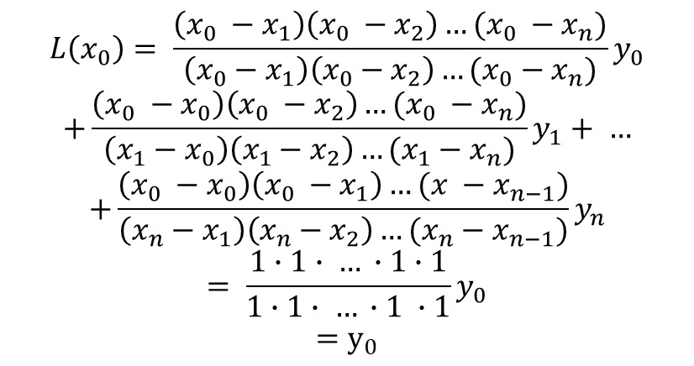
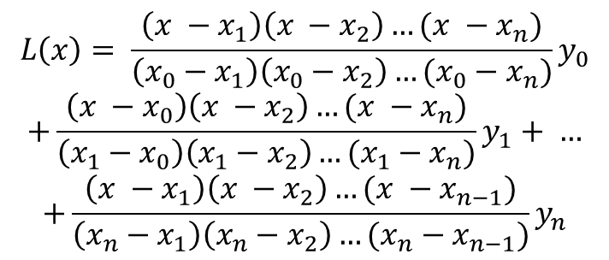
2.2 SSSS – Decryption / Lagrange Intp.
$$L\left(x\right)= \frac{\left(x −x_{1}\right)\left(x −x_{2}\right)…(x −x_{n})}{\left(x_{0}−x_{1}\right)\left(x_{0}−x_{2}\right)…(x_{0}−x_{n})}y_{0}$$
$$+\frac{\left(x −x_{0}\right)\left(x −x_{2}\right)…(x −x_{n})}{\left(x_{1}−x_{0}\right)\left(x_{1}−x_{2}\right)…(x_{1}−x_{n})}y_{1}+ …$$
$$+\frac{\left(x −x_{1}\right)\left(x −x_{2}\right)…(x −x_{n−1})}{\left(x_{n}−x_{1}\right)\left(x_{n}−x_{2}\right)…(x_{n}−x_{n−1})}y_{n}$$
$$L\left(x_{0}\right)= \frac{\left(x_{0} −x_{1}\right)\left(x_{0} −x_{2}\right)…(x_{0} −x_{n})}{\left(x_{0}−x_{1}\right)\left(x_{0}−x_{2}\right)…(x_{0}−x_{n})}y_{0}$$
$$+\frac{\left(x_{0} −x_{0}\right)\left(x_{0} −x_{2}\right)…(x_{0} −x_{n})}{\left(x_{1}−x_{0}\right)\left(x_{1}−x_{2}\right)…(x_{1}−x_{n})}y_{1}+ …$$
$$+\frac{\left(x_{0} −x_{0}\right)\left(x_{0} −x_{1}\right)…(x −x_{n−1})}{\left(x_{n}−x_{1}\right)\left(x_{n}−x_{2}\right)…(x_{n}−x_{n−1})}y_{n}$$
$$= \frac{1∙1∙ … ∙1∙1}{1∙1∙ … ∙1 ∙1}y_{0}$$
$$=y_{0}$$
Notes:
수식 소개
N+1개의 점을 지나는 다항식은 유일하다 << 이용

Slide 7
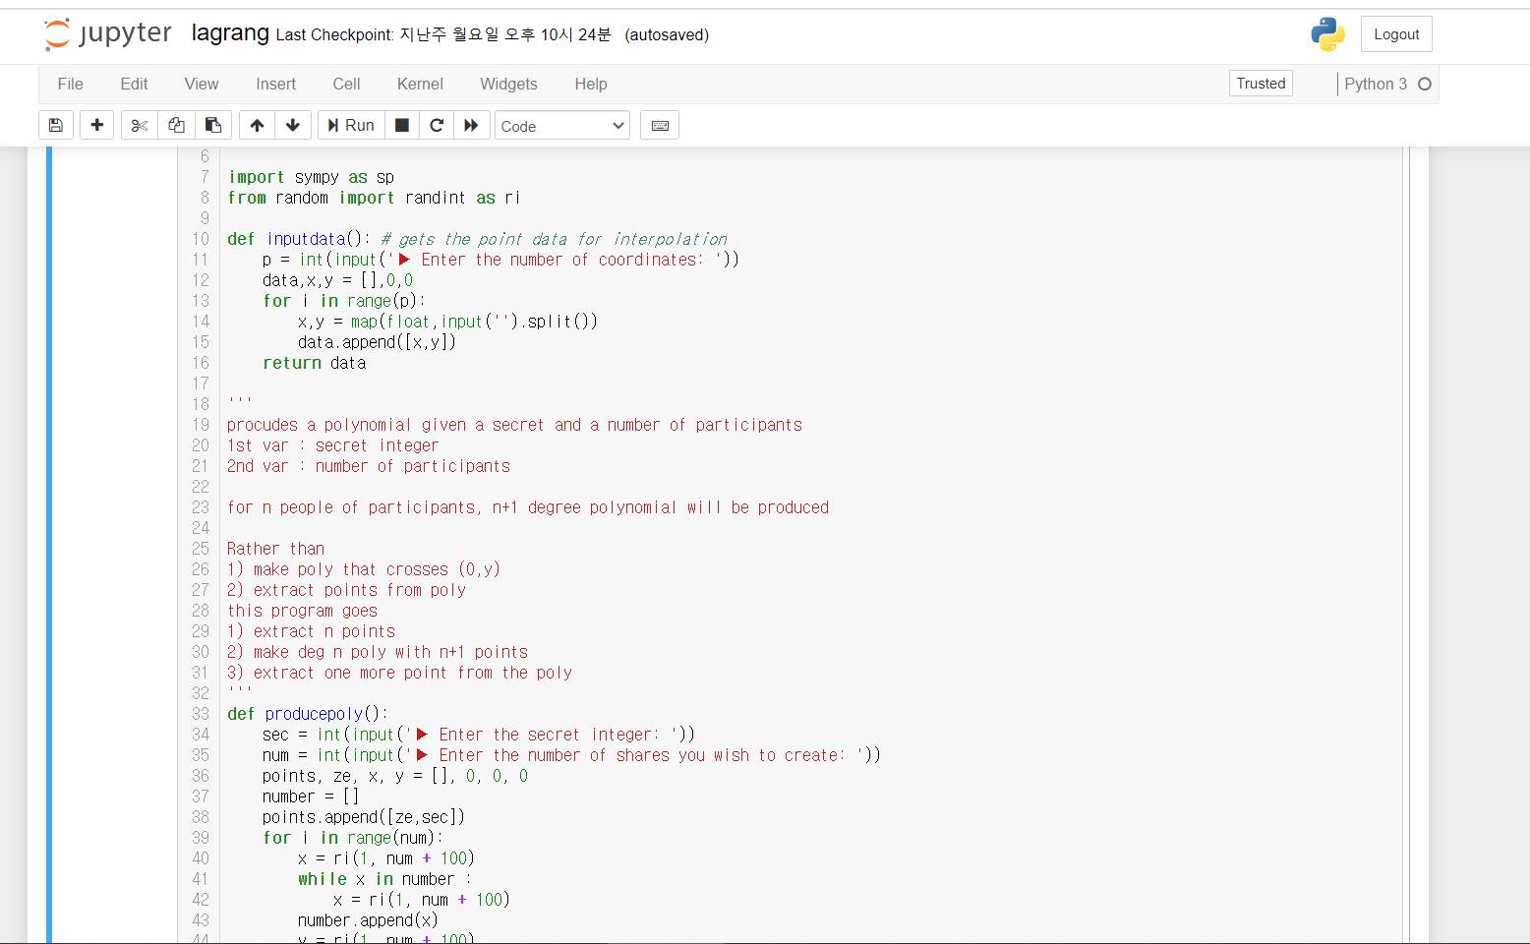
3.1 Implementation

Slide 8
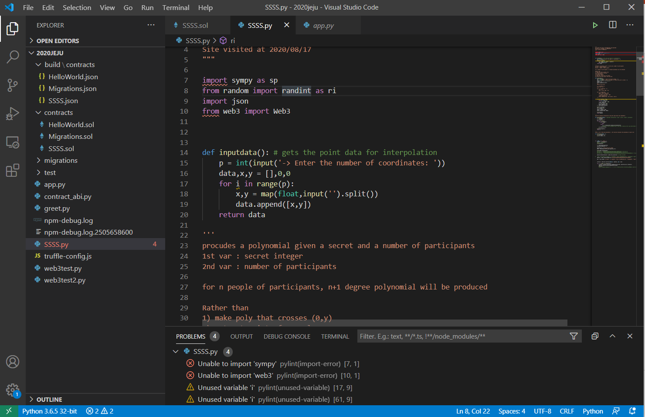
3.1 Implementation

Slide 9
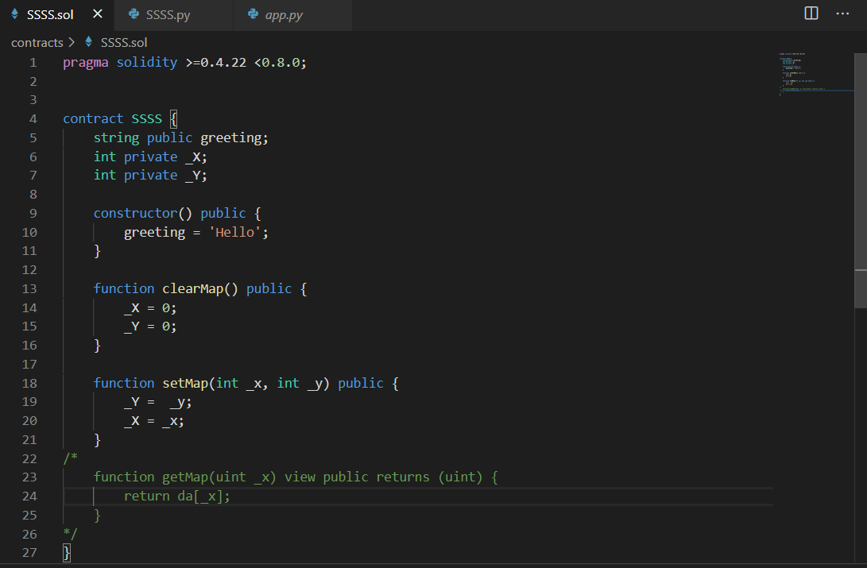
3.1 Implementation

Slide 10
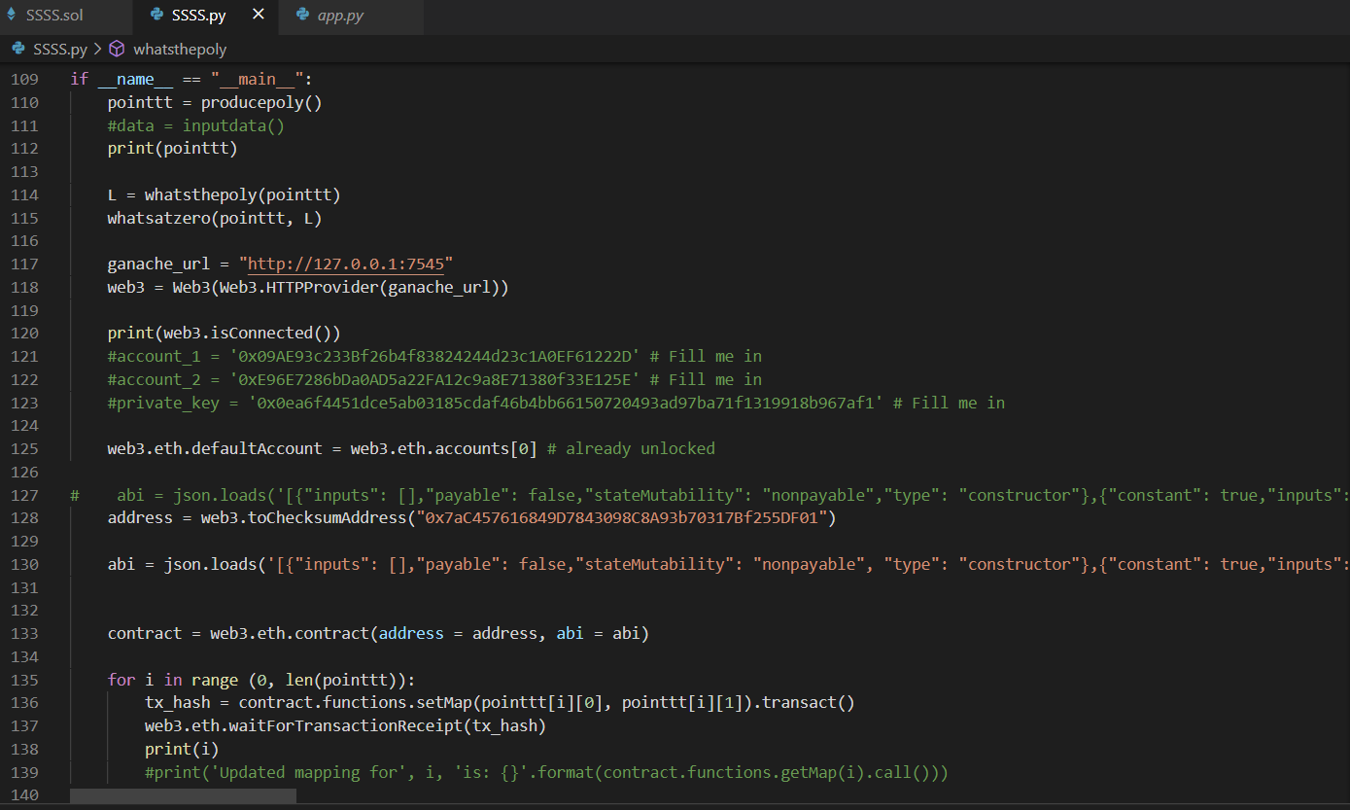
3.1 Implementation

Slide 11
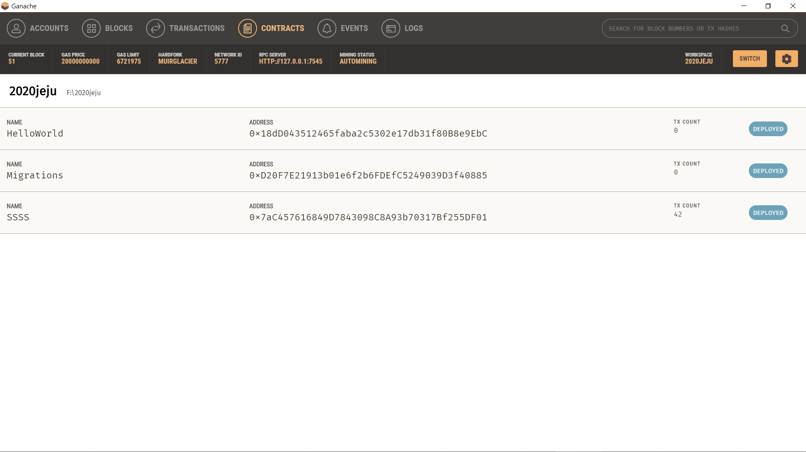
3.1 Implementation

Slide 12
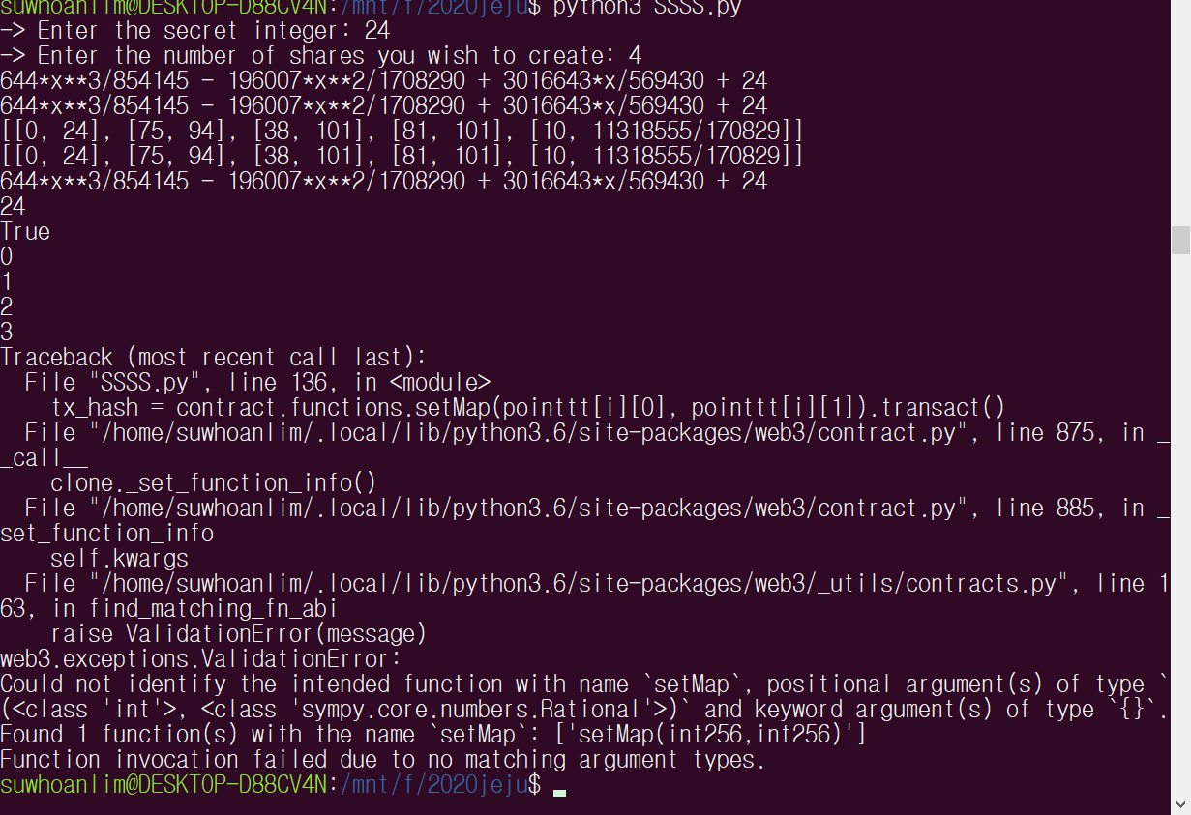
3.1 Implementation

Slide 13

3.1 Implementation

Slide 14
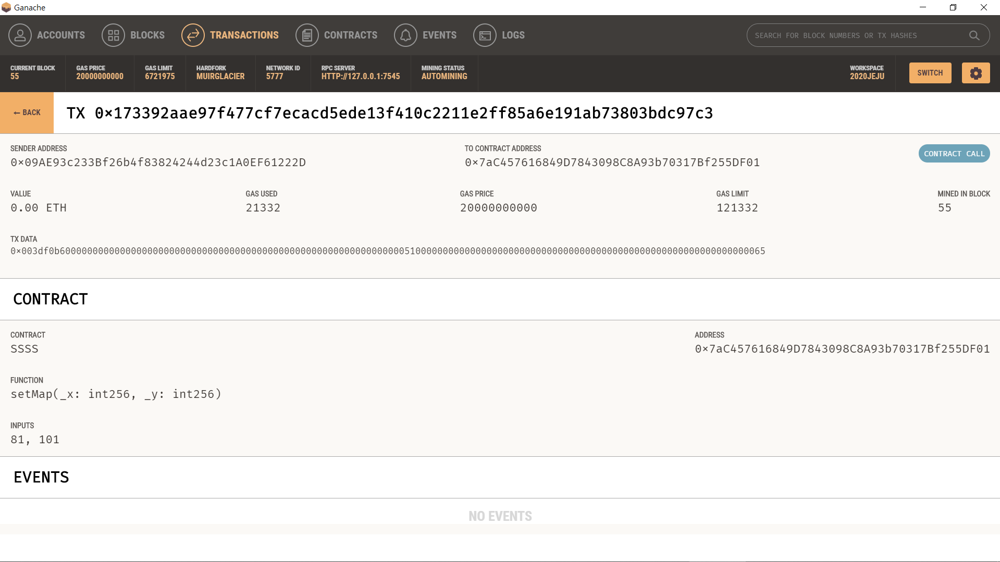

3.1 Implementation

Slide 15
4. Future Work
1. Clean up & Upload to Github
2. Update the Smart Contract to support floating point expression
3. Update Smart Contract for interactive support for SSSS
4. Wrap up / Upload everything to Github
Notes:
Have the data stored inside the solidity program
Make a github page, write readme

Slide 16
Thank You For Your Attention

Slide 17

Github Link:
github.com/suwhoanlim/2020UMLC
GitHub

Slide 18


Partially,
the works were done in UMLC2020 camp supported by

